Slide 1
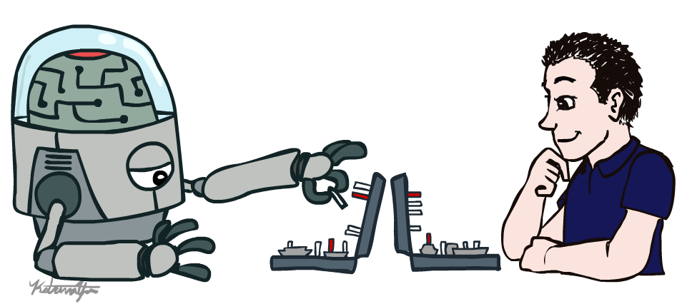
CS 188: Artificial Intelligence
Introduction
Instructors: Anca Dragan, Pieter Abbeel
University of California, Berkeley
(slides adapted from Dan Klein, Pieter Abbeel)

Slide 2
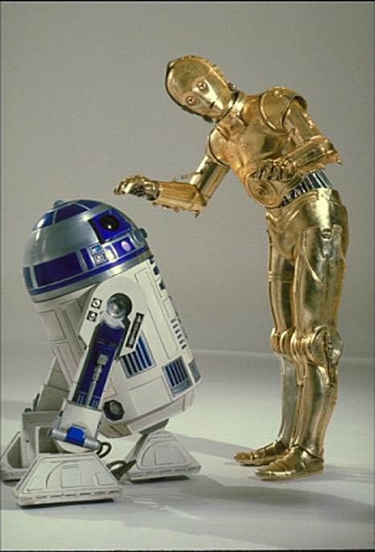
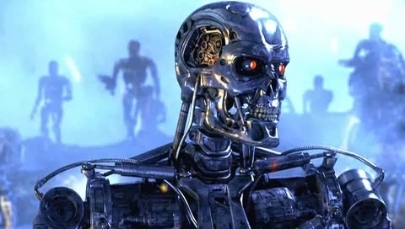
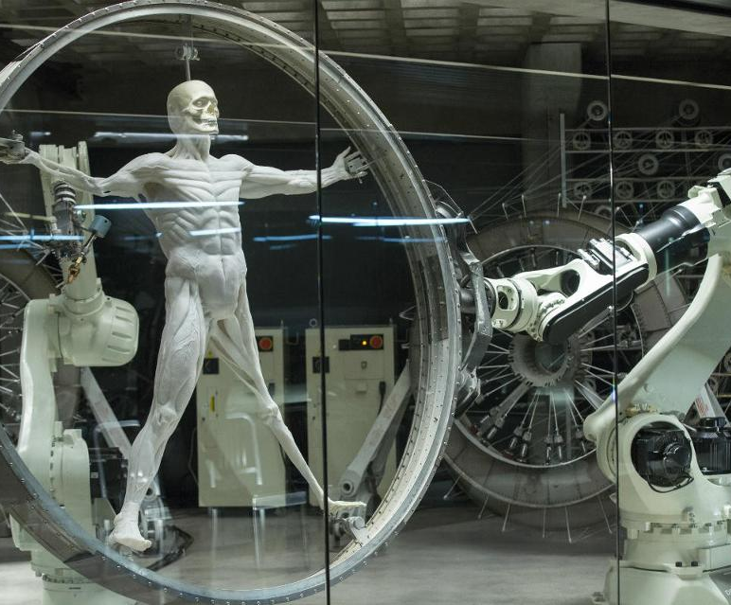
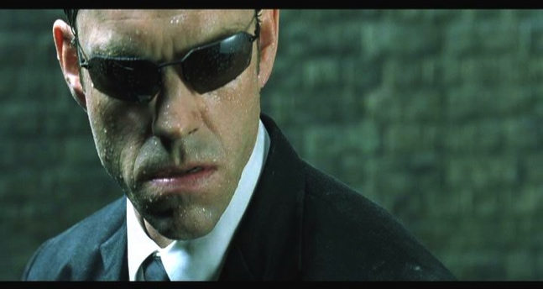
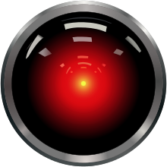
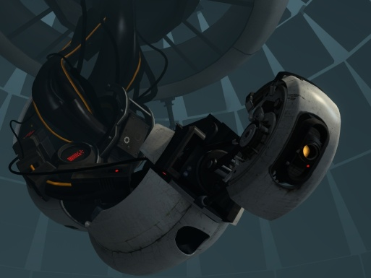
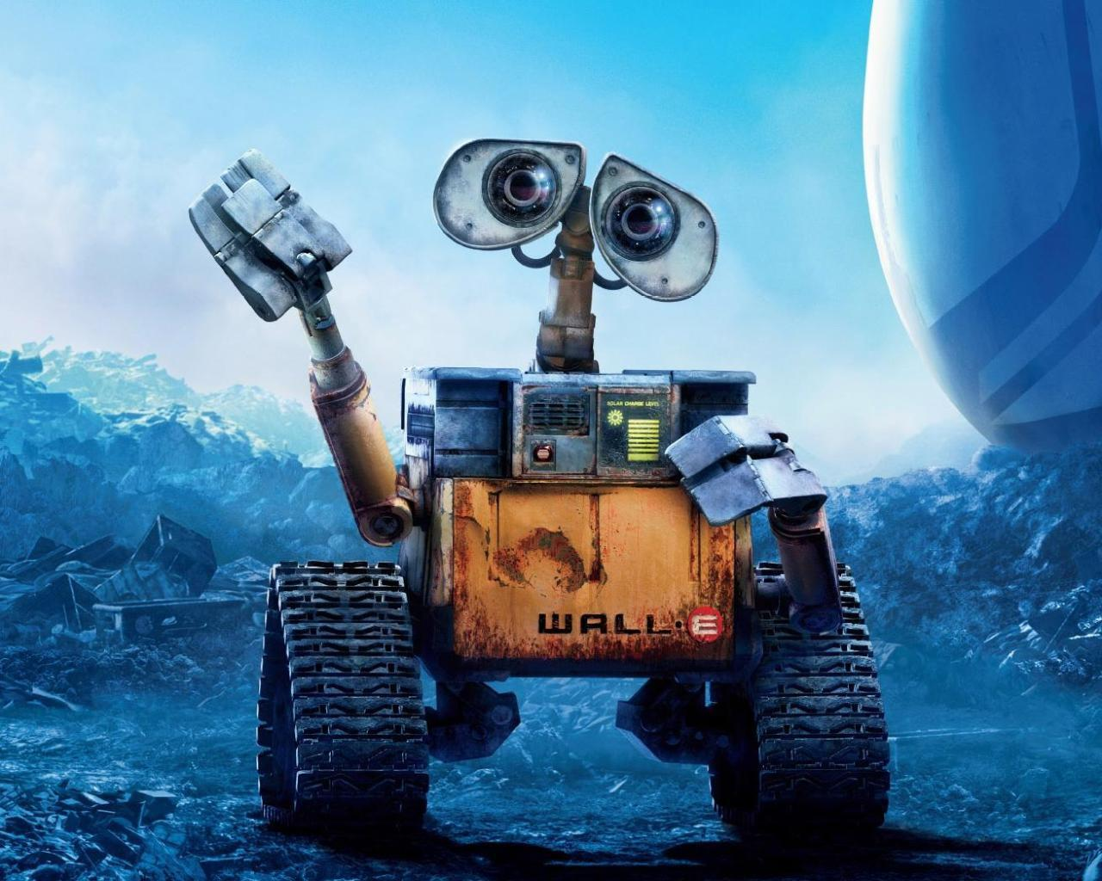
AI
Notes:
Who are these? C3PO, what does he do? Essentially google translate, (but with anxiety!)
Little guy? R2D2 – what does he do, yeah, not so sure
Things got darker: machines come back from the future – to kill us!
90’s : software is scary
Basic fear about what technology might do ?
What if we can’t even tell technology apart from ourselves?
OR maybe it’ll look really different and snarky
Some exceptions like wall-E, positive view of technology (but maybe not of us humans!)
But mostly a worry
[not very worried myself, at least at present]

Slide 3
Notes:
Robots look like this. We have autonomous cars that figure out how to take us to our destination

Slide 4
Notes:
Robots help nurses in hospitals deliver stuff to different rooms

Slide 5
Notes:
Or drones that record cooll videos of us as we do outdoor activities
Or in my case,

Slide 6

Notes:
as we get married.

Slide 7
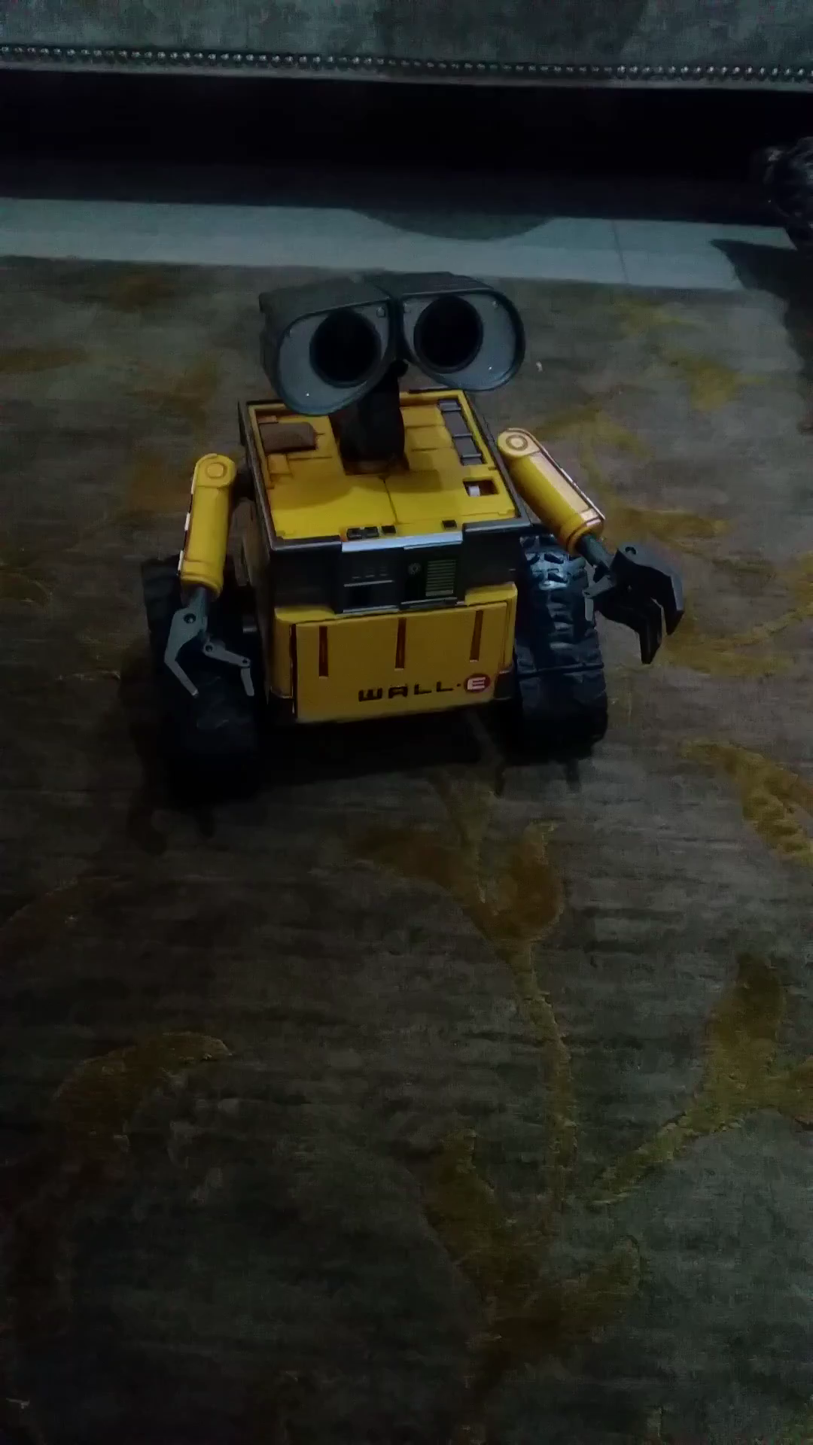
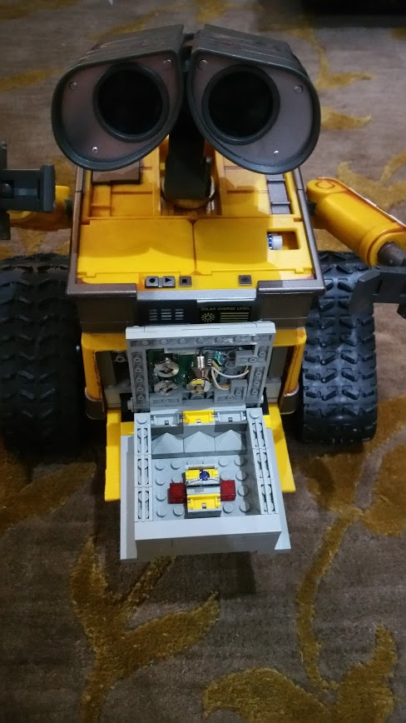
AI

Slide 8
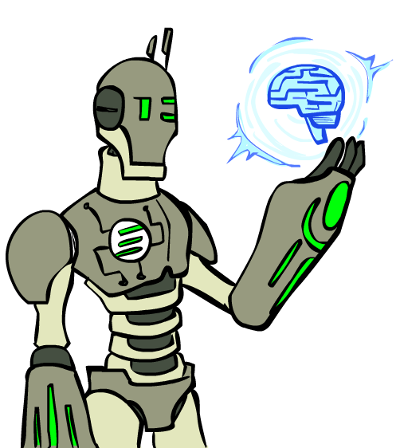
Today
What is artificial intelligence?
Where did it come from/What can AI do?
What should we and shouldn’t we worry about? What can we do about the things we should worry about?
What is this course?

Slide 9
This lecture:
What is it / what are the basics of how it works?
What are things we should and should not worry about?
How might we fix the things we should worry about?

Slide 10
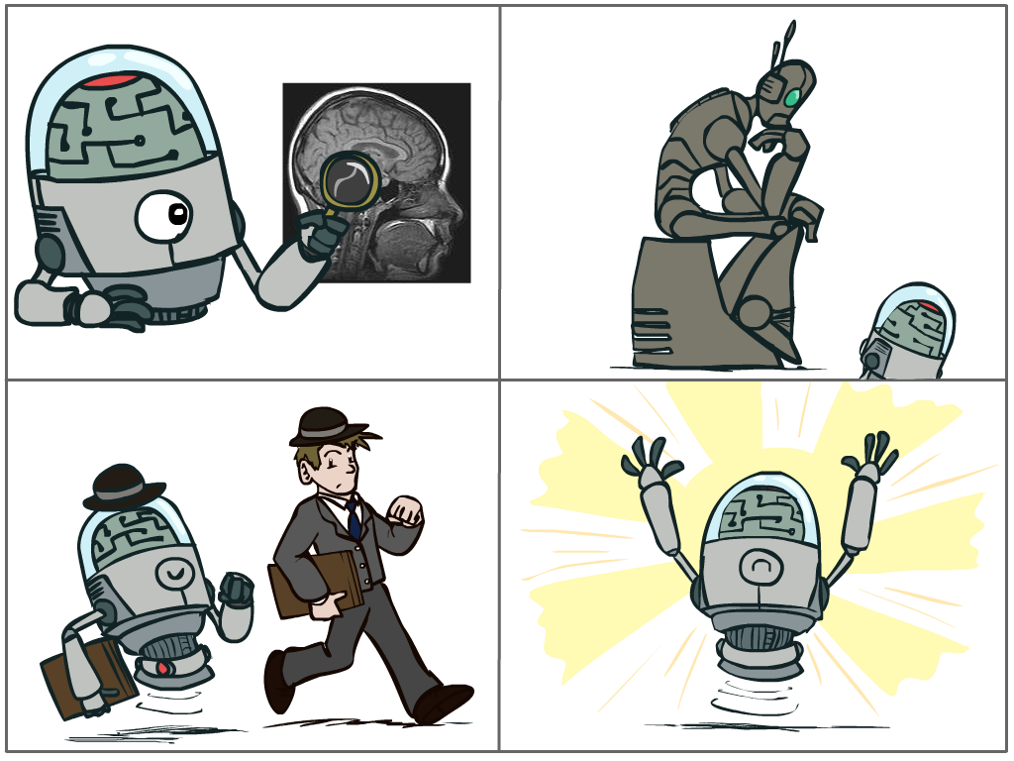
What is AI?
The science of making machines that:
Think like people
Think rationally
Act like people
Act rationally
Notes:
Top left: natural intelligence -- Think like people --- cognitive science, neuroscience
Bottom left: who cares about how they think? act like people --- actually very early definition, dating back to Alan Turing --- Turing test; problem to do really well you start focusing on things like don’t answer too quickly what the square root of 1412 is, don’t spell too well, and make sure you have a favorite movie etc. So it wasn’t really leading us to build intelligence
Think rationally – correct thought process -- long tradition dating back to Aristotle --- this is how to think so that you don’t make mistakes; but not a winner, because difficult to encode how to think / especially in the face of unknowns/uncertainty, and in the end it’s not about how you think, it’s about how you end up acting

Slide 11
Rational Decisions
We’ll use the term rational in a very specific, technical way:
Rational: maximally achieving pre-defined goals
Rationality only concerns what decisions are made
(not the thought process behind them)
Goals are expressed in terms of the utility of outcomes
Being rational means maximizing your expected utility
A better title for this course would be:
Computational Rationality
Notes:
Not about building machines that don’t get angry
Example of utilities. 10 for A, 1 for each Friday with friends

Slide 12
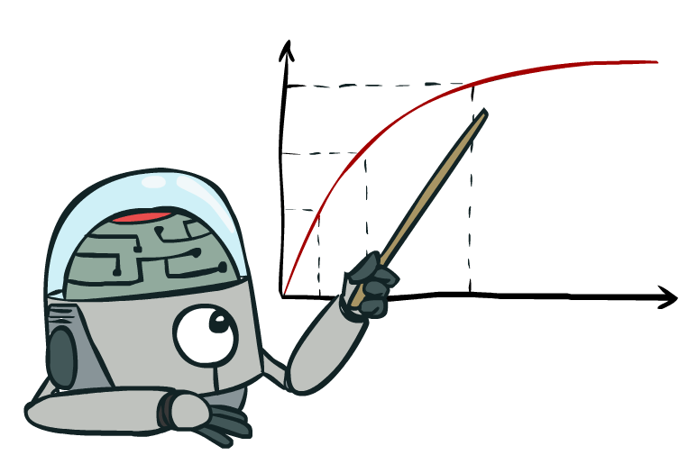
Maximize Your
Expected Utility
Notes:
Distill course to maximize expected utility

Slide 13
Maximize Your
Expected Utility
Notes:
Consequences of an action, context, other actors around

Slide 14
Maximize Your
Expected Utility
Notes:
What is a utility

Slide 15
Maximize Your
Expected Utility
Notes:
rationality not about being successful – doing the right thing on average

Slide 16
Maximize Your
Expected Utility
Notes:
Very end – who is your? How do you get that?

Slide 17
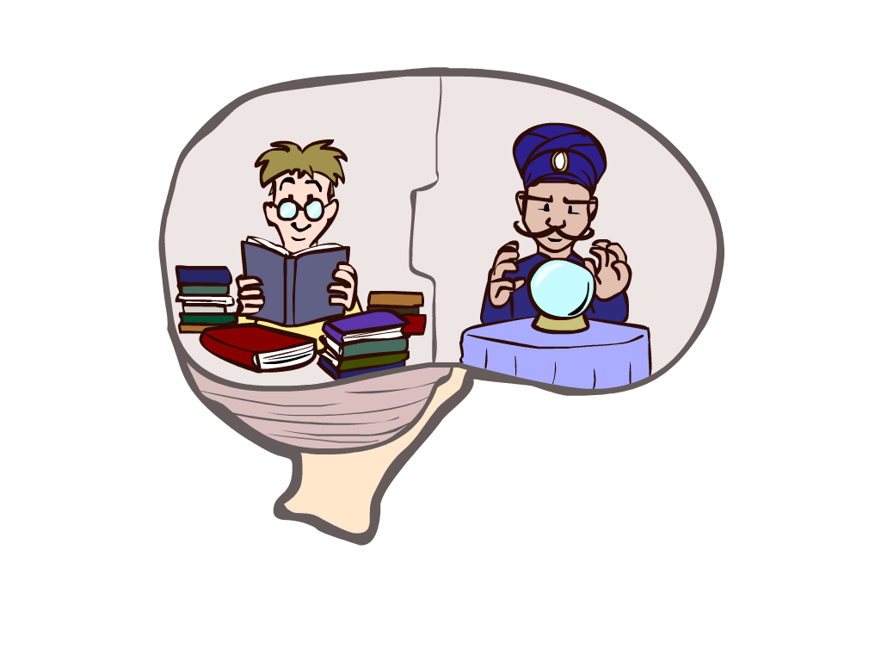
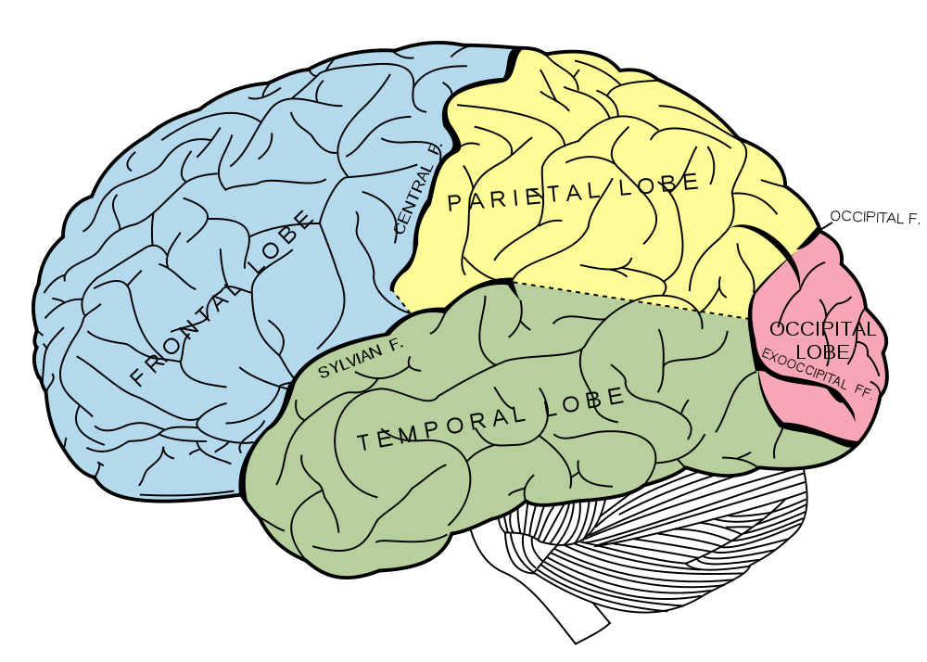
What About the Brain?
Brains (human minds) are very good at making rational decisions, but not perfect
Brains aren’t as modular as software, so hard to reverse engineer!
“Brains are to intelligence as wings are to flight”
Lessons learned from the brain: memory and simulation are key to decision making
Notes:
Stopped making wings that flap

Slide 18
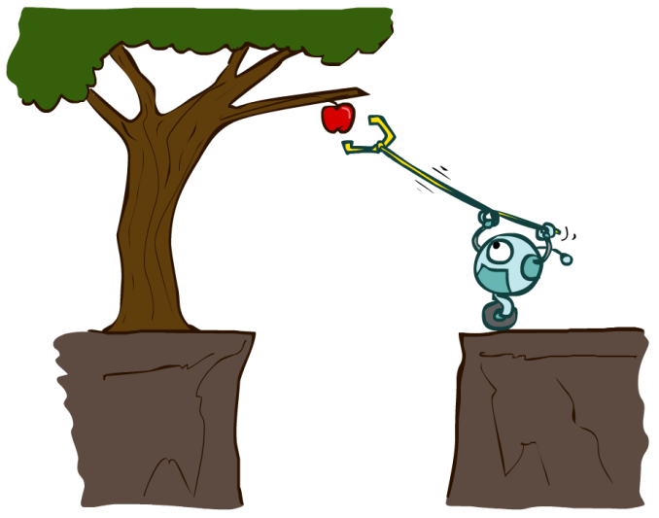
Designing Rational Agents
An agent is an entity that perceives and acts.
A rational agent selects actions that maximize its (expected) utility.
Characteristics of the percepts, environment, and action space dictate techniques for selecting rational actions
This course is about:
General AI techniques for a variety of problem types
Learning to recognize when and how a new problem can be solved with an existing technique
Sensors
Agent
Percepts
Environment
?
Actuators
Actions

Slide 19
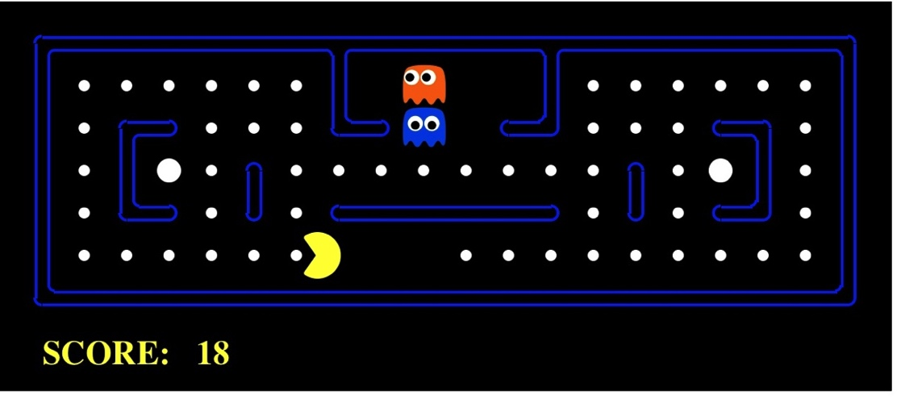
Pac-Man as an Agent
Agent
Environment
Sensors
Percepts
?
Actuators
Actions
Pac-Man is a registered trademark of Namco-Bandai Games, used here for educational purposes
Demo1: pacman-l1.mp4

Slide 20


Slide 21
Logistics!

Slide 22


Slide 23
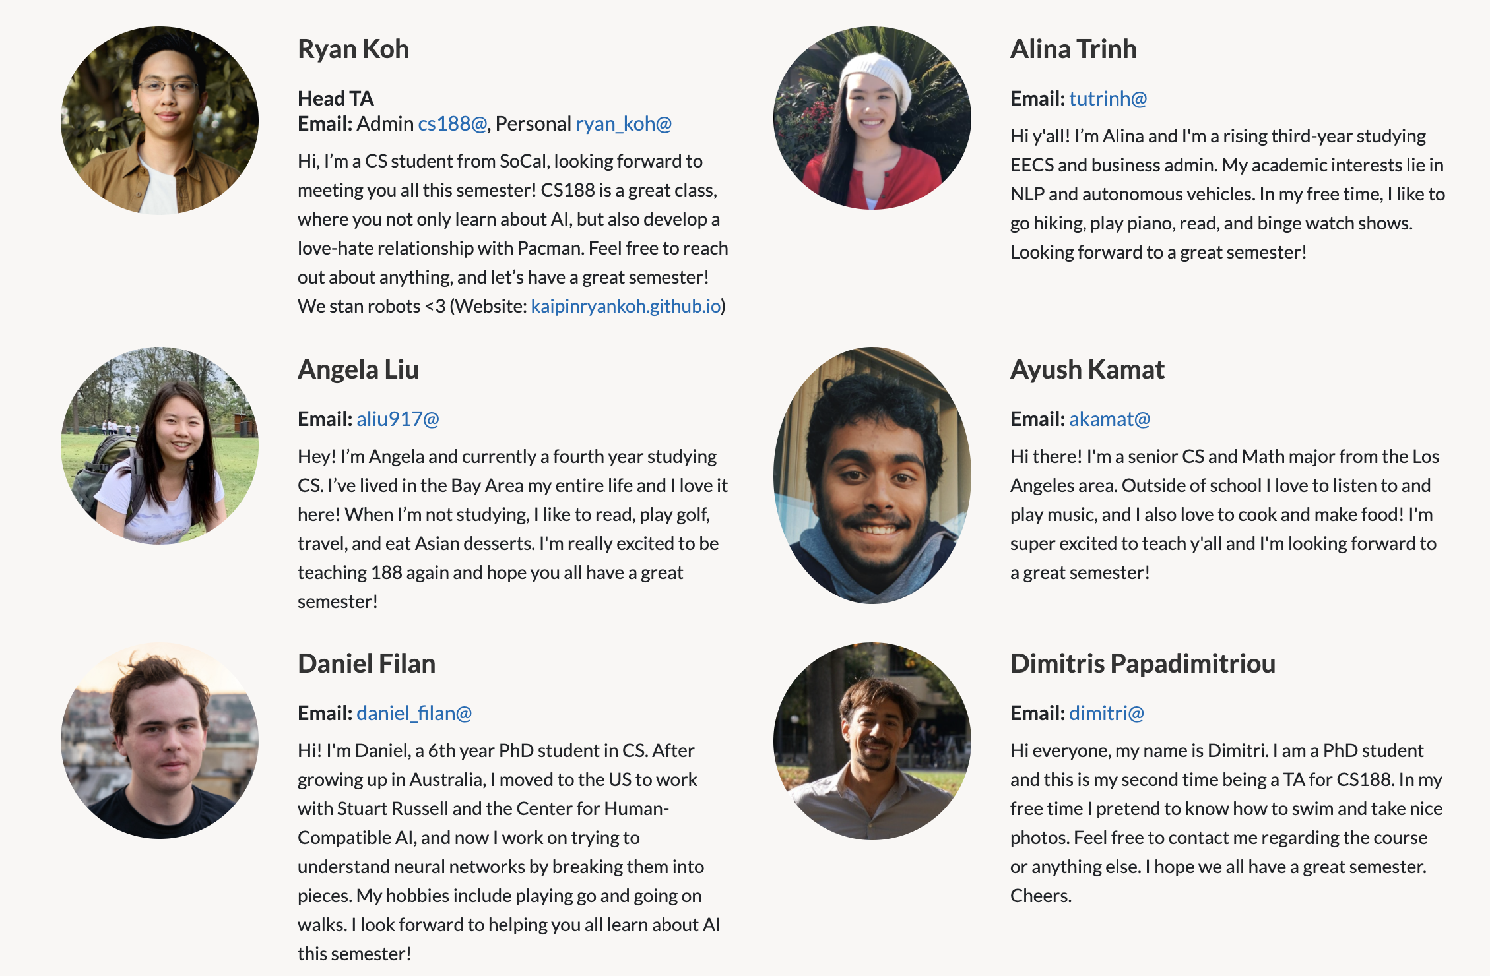

Slide 24
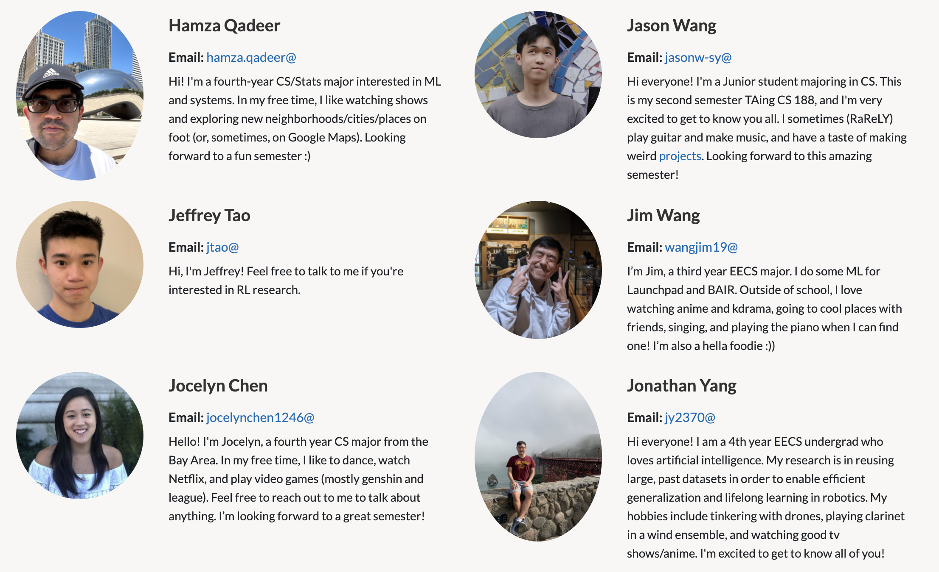

Slide 25
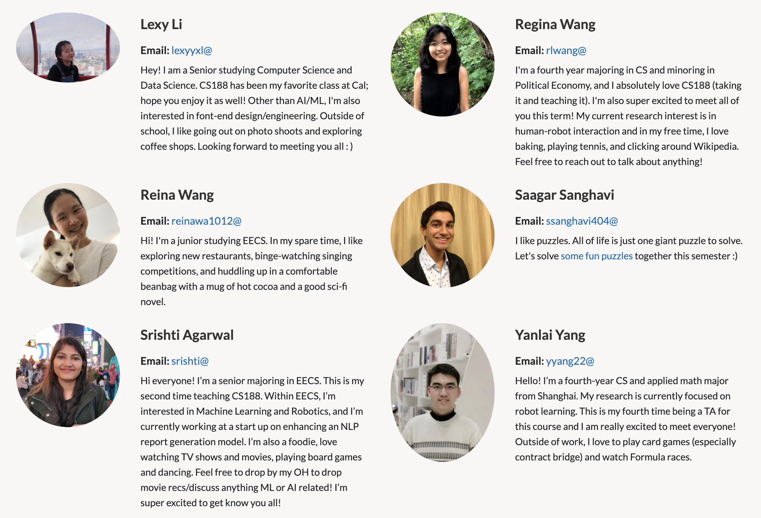

Slide 26
